Slide 1
Single-variate Linear Regression with Bias Term 2
Deep-Learning Seminar ch.8

Slide 2
Contents
1. for Several Samples - Implementation
2. SVLR - Analysis1
3. SVLR – Analysis2
4. SVLR – Analysis3

Slide 3
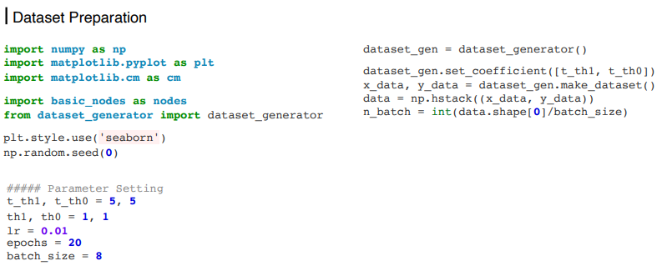
For Several Samples - Implementation

Slide 4
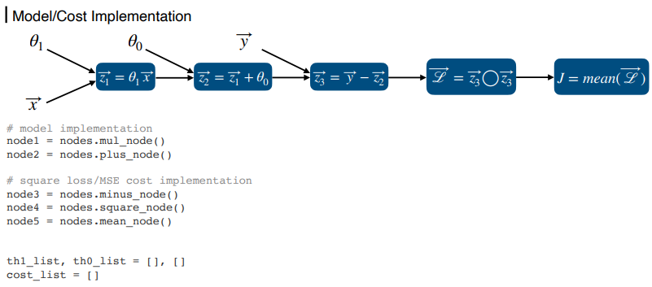
For Several Samples - Implementation

Slide 5
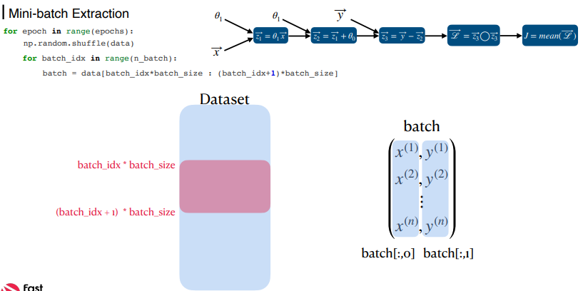
For Several Samples - Implementation

Slide 6
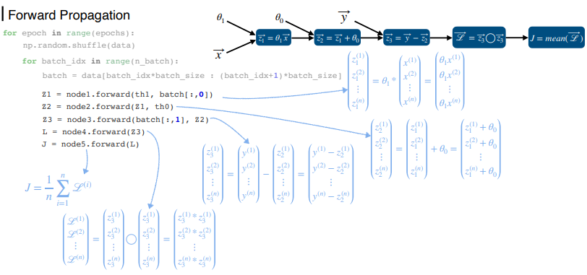
For Several Samples - Implementation

Slide 7
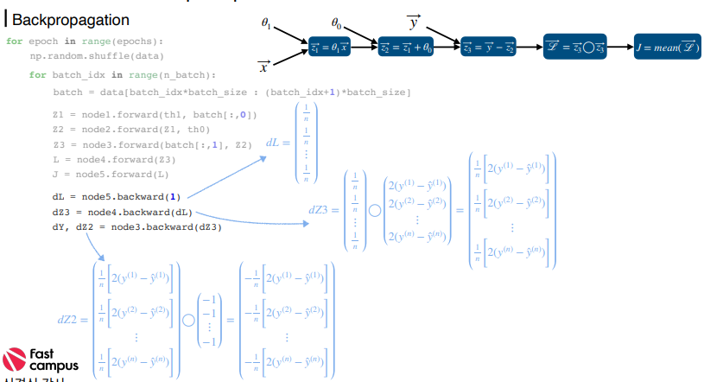
For Several Samples - Implementation

Slide 8
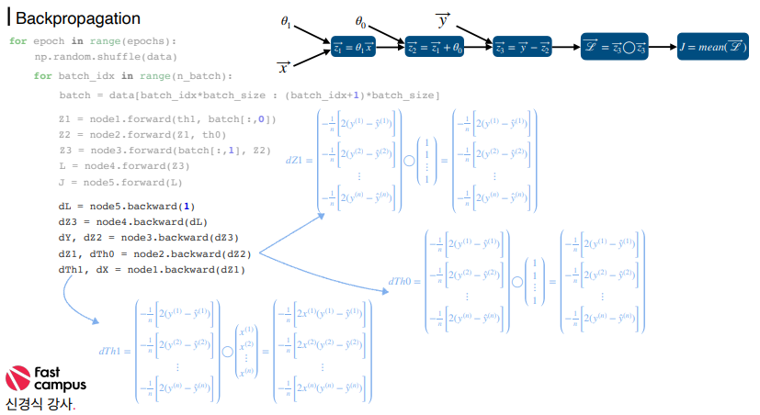
For Several Samples - Implementation

Slide 9
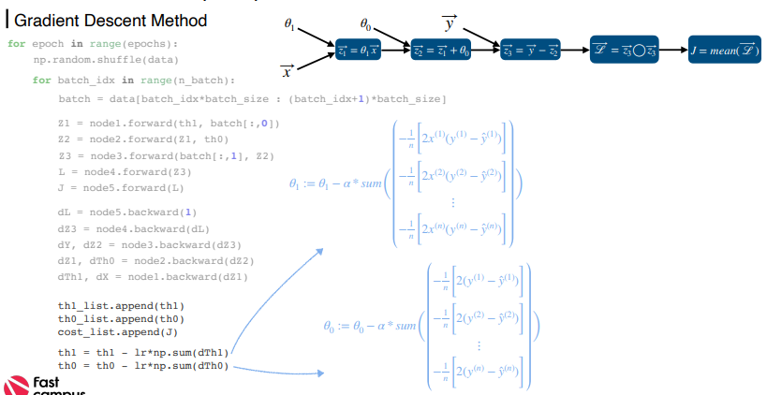
For Several Samples - Implementation

Slide 10
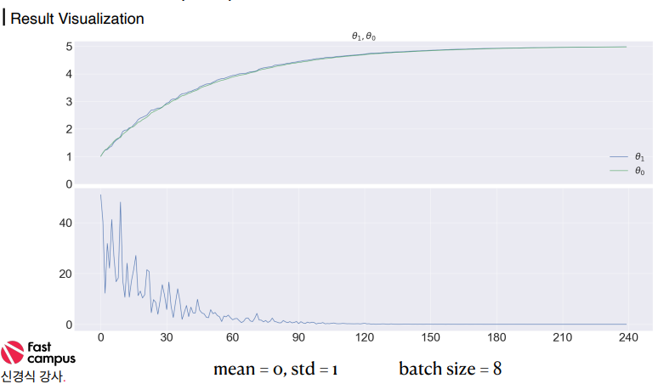
For Several Samples - Implementation

Slide 11
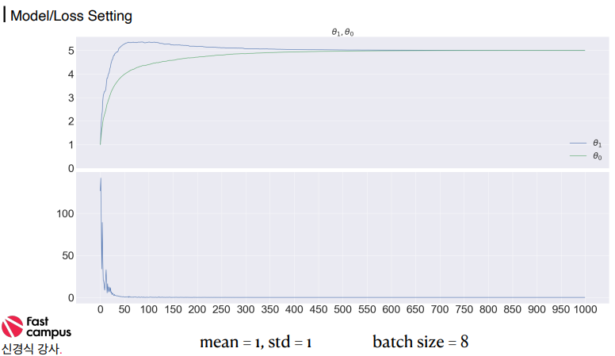
For Several Samples - Implementation

Slide 12
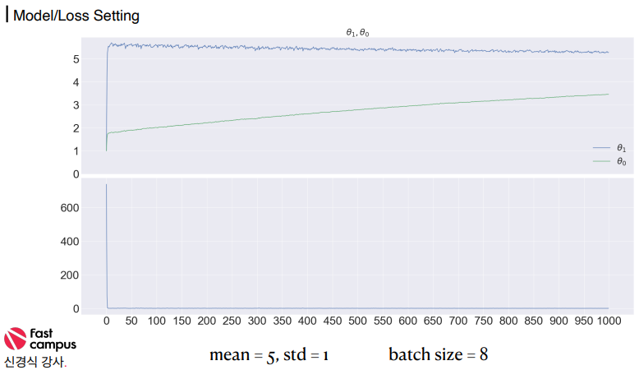
For Several Samples - Implementation

Slide 13
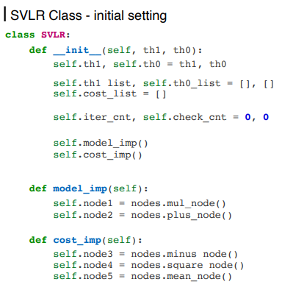
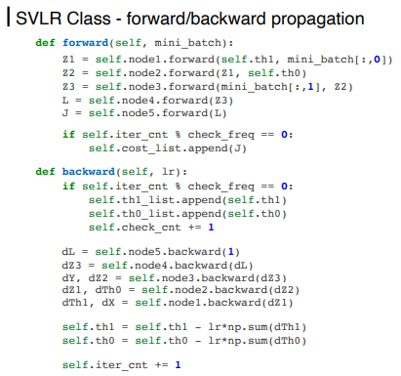
For Several Samples - Implementation

Slide 14
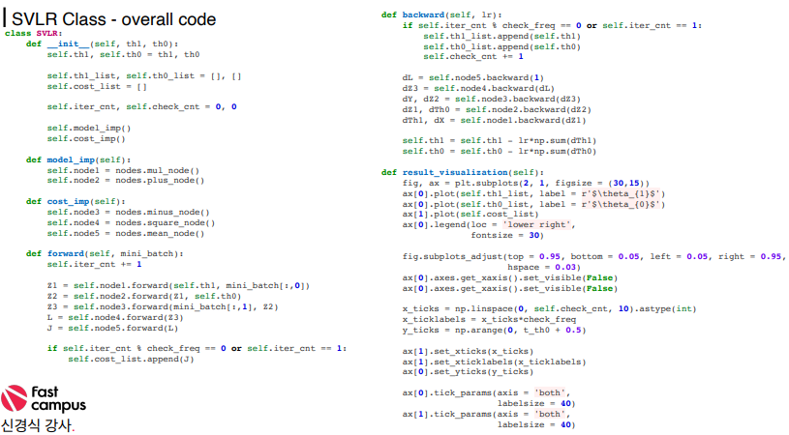
For Several Samples - Implementation

Slide 15
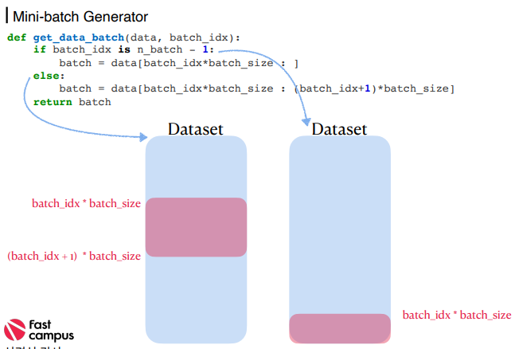
For Several Samples - Implementation

Slide 16
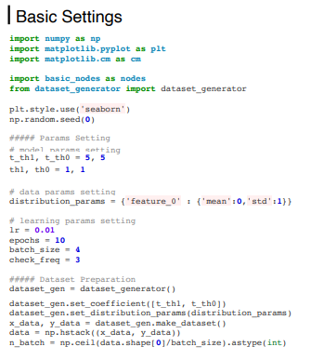
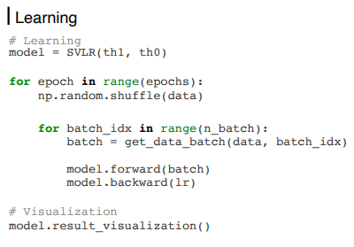
For Several Samples - Implementation

Slide 17
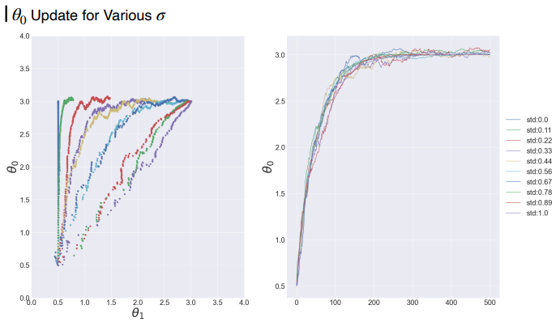
SVLR - Analysis1

Slide 18
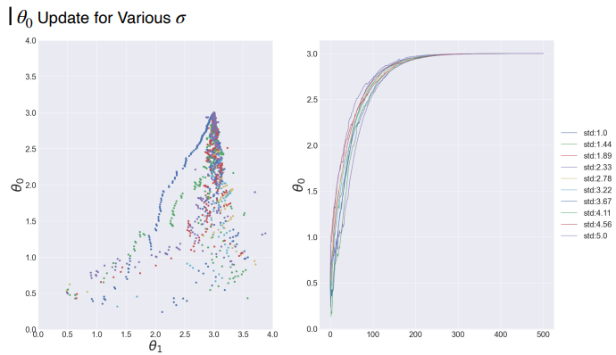
SVLR - Analysis1

Slide 19
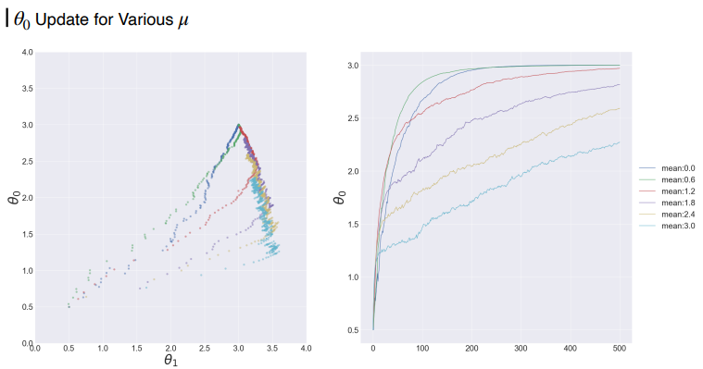
SVLR - Analysis1

Slide 20
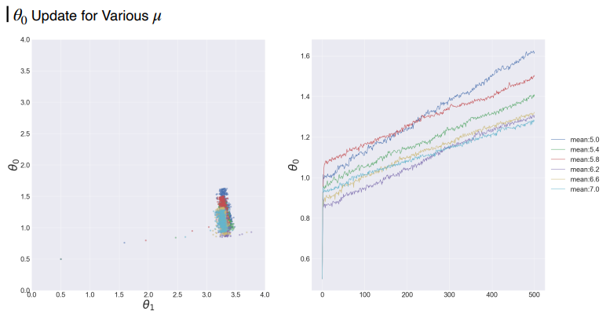
SVLR - Analysis1

Slide 21
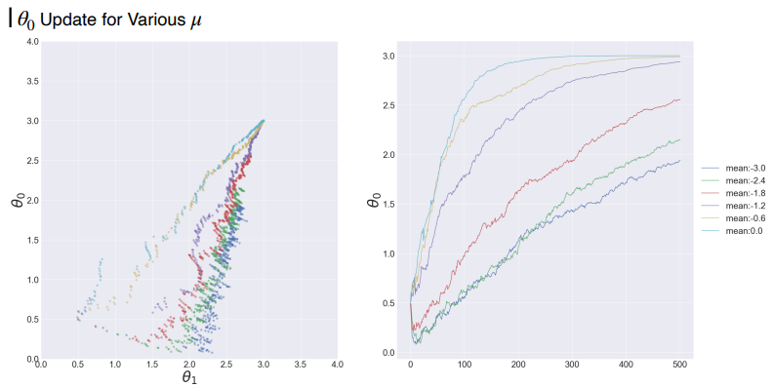
SVLR - Analysis1

Slide 22
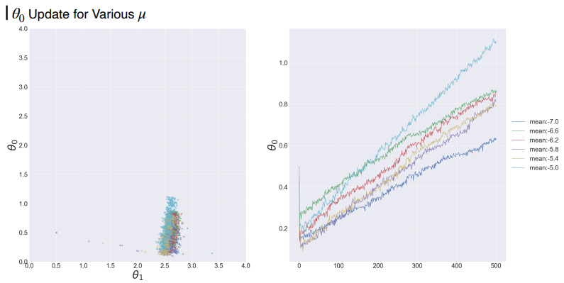
SVLR - Analysis1

Slide 23
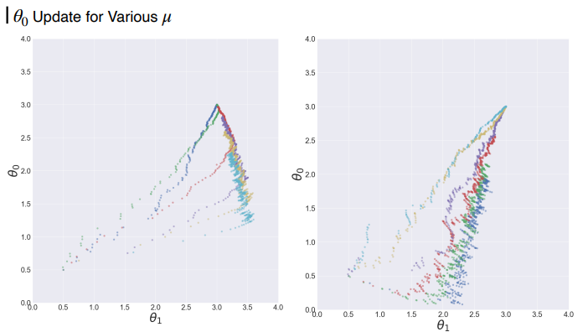
SVLR - Analysis1

Slide 24
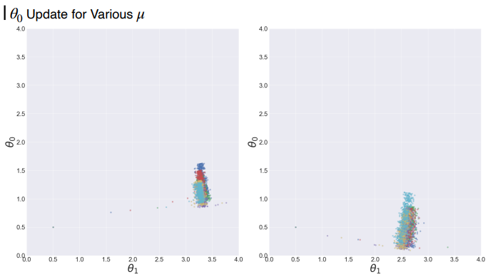
SVLR - Analysis1

Slide 25
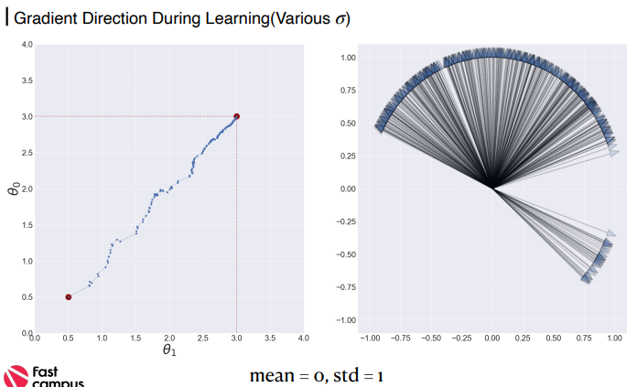
SVLR – Analysis2

Slide 26
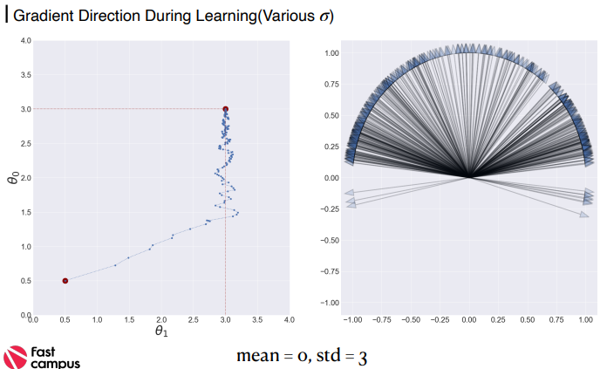
SVLR – Analysis2

Slide 27
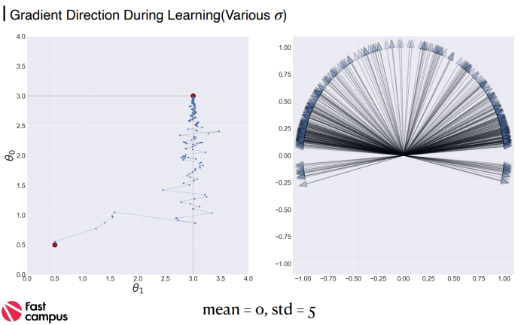
SVLR – Analysis2

Slide 28
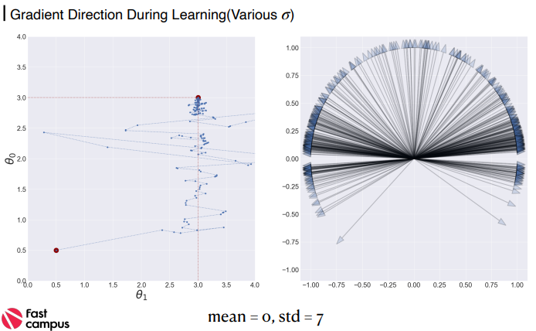
SVLR – Analysis2

Slide 29
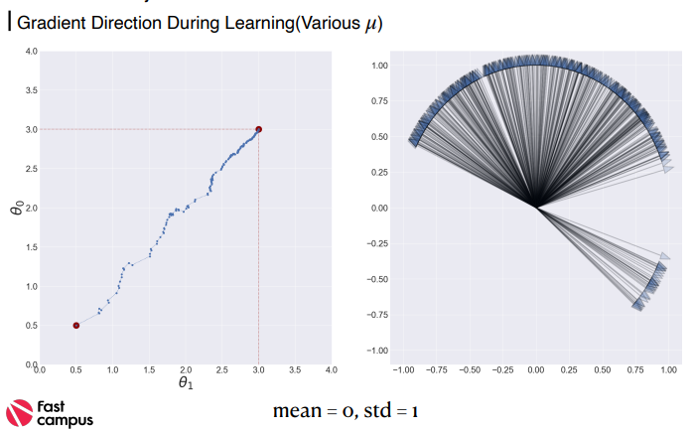
SVLR – Analysis2

Slide 30
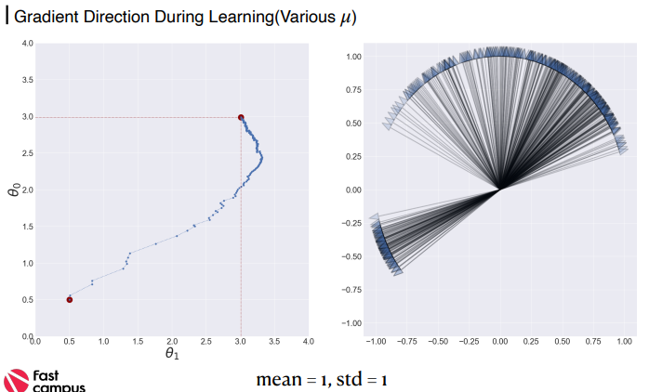
SVLR – Analysis2

Slide 31
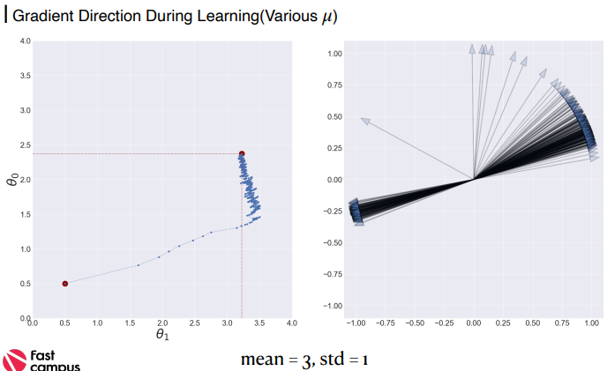
SVLR – Analysis2

Slide 32
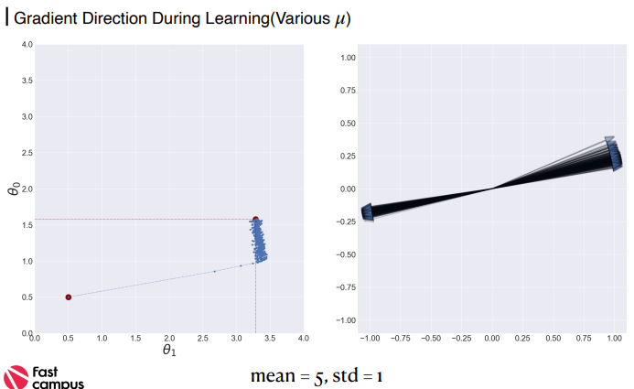
SVLR – Analysis2

Slide 33
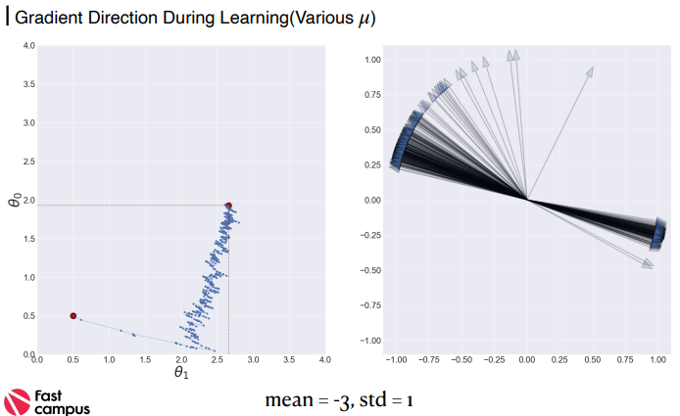
SVLR – Analysis2

Slide 34
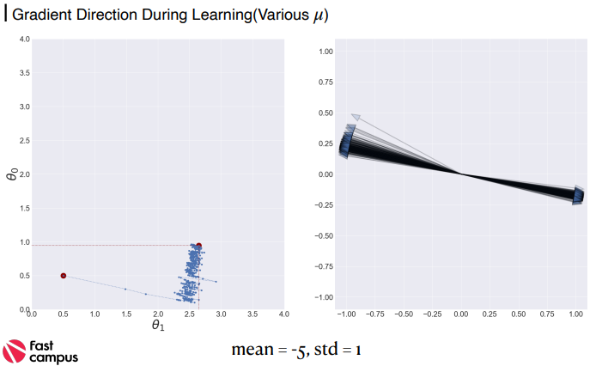
SVLR – Analysis2

Slide 35
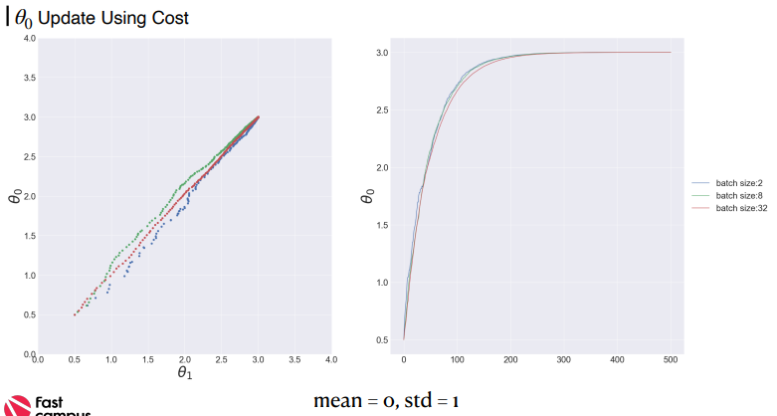
SVLR – Analysis3

Slide 36
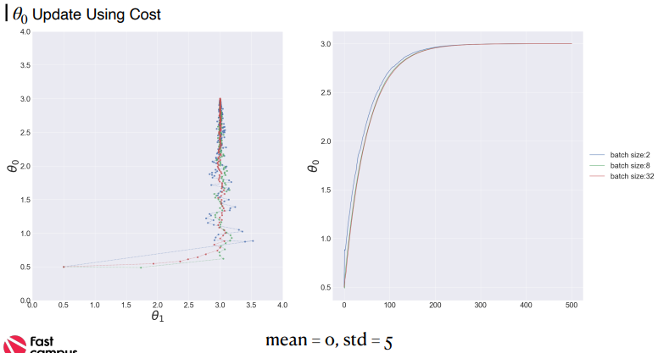
SVLR – Analysis3

Slide 37
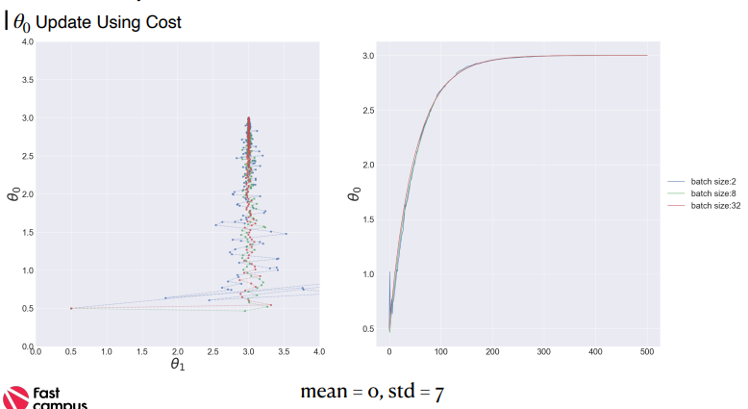
SVLR – Analysis3

Slide 38
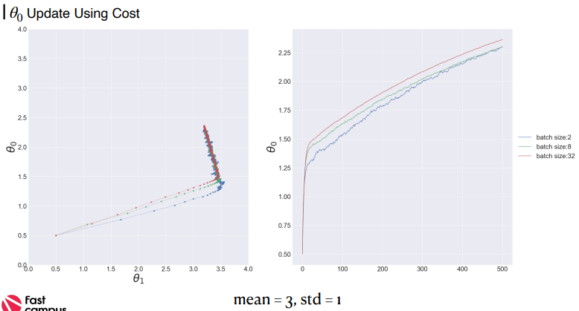
SVLR – Analysis3

Slide 39
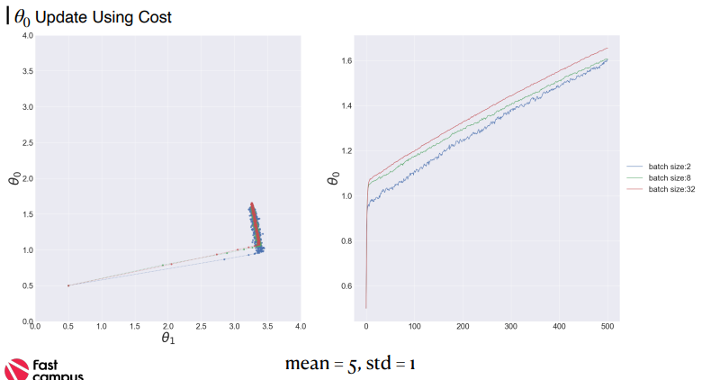
SVLR – Analysis3

Slide 40
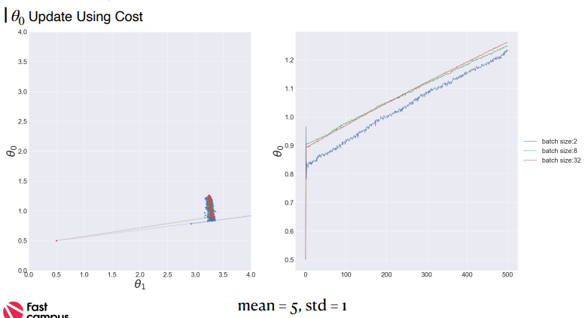
SVLR – Analysis3

Slide 41
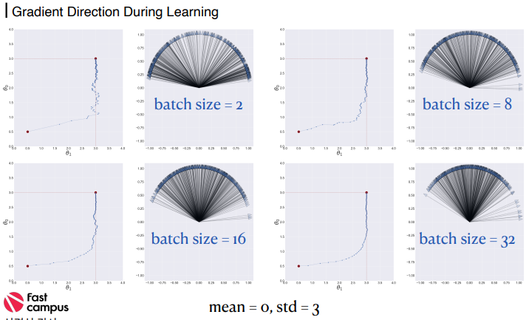
SVLR – Analysis3

Slide 42
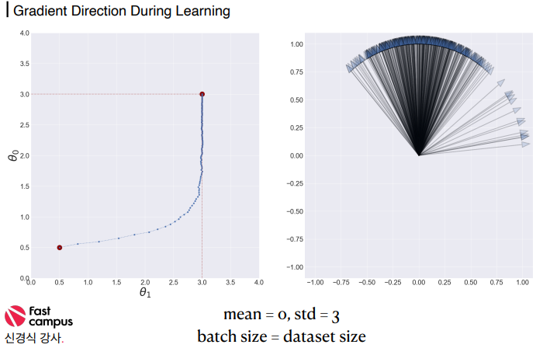
SVLR – Analysis3

Slide 43
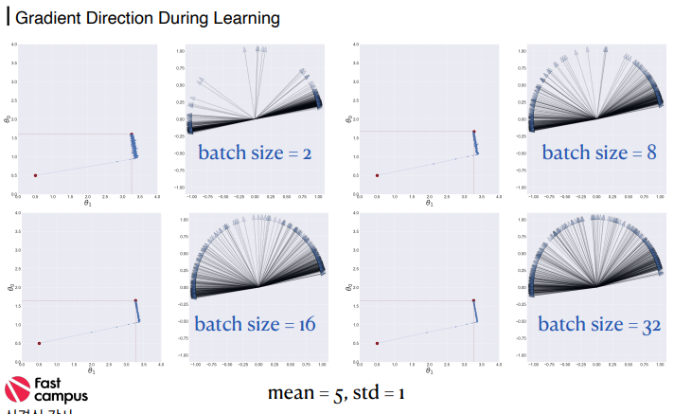
SVLR – Analysis3

Slide 44
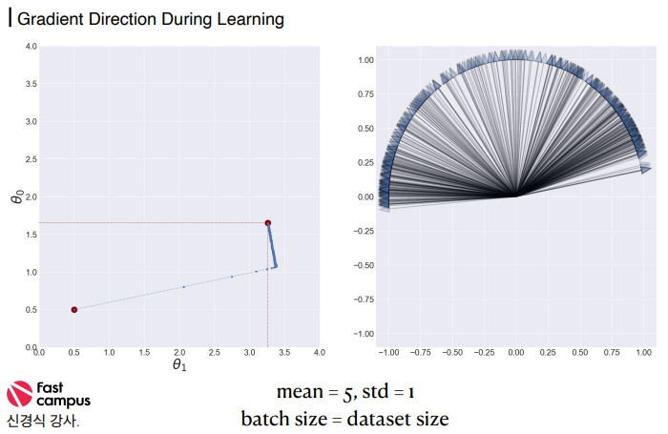
SVLR – Analysis3

Slide 45
감사합니다.

